Slide 1
Core concepts in IR
Query representation
Lexical gap: say v.s. said
Semantic gap: ranking model v.s. retrieval method
Document representation
Special data structure for efficient access
Lexical gap and semantic gap
Retrieval model
Algorithms that find the most relevant documents for the given information need

Slide 2
IR v.s. DBs
Information Retrieval:
Unstructured data
Semantics of objects are subjective
Simple keyword queries
Relevance-driven retrieval
Effectiveness is primary issue, though efficiency is also important
Database Systems:
Structured data
Semantics of each object are well defined
Structured query languages (e.g., SQL)
Exact retrieval
Emphasis on efficiency

Slide 3
Abstraction of search engine architecture
Indexed corpus
Crawler
Ranking procedure
Feedback
Evaluation
Doc Analyzer
(Query)
Query Rep
User
Doc Representation
Ranker
Indexer
results
Index

Slide 4
Visiting strategy
Breadth first
Uniformly explore from the entry page
Memorize all nodes on the previous level
As shown in pseudo code
Depth first
Explore the web by branch
Biased crawling given the web is not a tree structure
Focused crawling
Prioritize the new links by predefined strategies

Slide 5
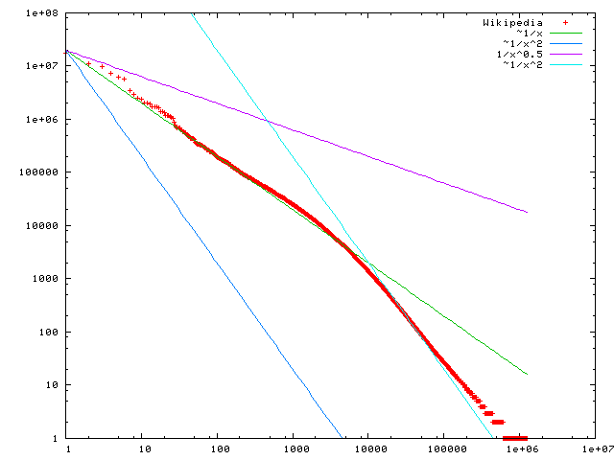
Statistical property of language
discrete version of power law
Word frequency
Word rank by frequency
A plot of word frequency in Wikipedia (Nov 27, 2006)

Slide 6
Zipf’s law tells us
Head words may take a large portion of occurrence, but they are semantically meaningless
E.g., the, a, an, we, do, to
Tail words take major portion of vocabulary, but they rarely occur in documents
E.g., dextrosinistral
The rest is most representative
To be included in the controlled vocabulary

Slide 7
Complexity analysis
Time complexity analysis
$O(\left|q\right|∗D∗|D|)$
$\left|q\right|$ is the length of query, $|D|$ is the length of a document
doclist = []
for (wi in q) {
for (d in D) {
for (wj in d) {
if (wi == wj) {
doclist += [d];
break;
}
}
}
}
return doclist;
Bottleneck, since most of them won’t match!

Slide 8
Solution: inverted index
Build a look-up table for each word in vocabulary
From word to documents!
Dictionary
Postings
information
retrieval
retrieved
is
helpful
for
you
everyone
Doc1
Doc2
Time complexity:
$O(\left|q\right|∗|L|)$, $|L|$ is the average length of posting list
By Zipf’s law, $\left|L\right|≪D$
Doc1
Query:
information
retrieval
Doc2
Doc1
Doc2
Doc1
Doc2
Doc1
Doc2
Doc2
Doc1

Slide 9
Structures for inverted index
Dictionary: modest size
Needs fast random access
Stay in memory
Hash table, B-tree, trie, …
Postings: huge
Sequential access is expected
Stay on disk
Contain docID, term freq, term position, …
Compression is needed
“Key data structure underlying modern IR”
- Christopher D. Manning

Slide 10
Sorting-based inverted index construction
<Tuple>: <termID, docID, count>
Sort by docId
Sort by termId
All info about term 1
doc1
<1,1,3>
<2,1,2>
<3,1,1>
...
<1,2,2>
<3,2,3>
<4,2,5>
…
<1,300,3>
<3,300,1>
...
<1,1,3>
<1,2,2>
<2,1,2>
<2,4,3>
...
<1,5,3>
<1,6,2>
…
<1,299,3>
<1,300,1>
...
<1,1,3>
<1,2,2>
<1,5,2>
<1,6,3>
...
<1,300,3>
<2,1,2>
…
<5000,299,1>
<5000,300,1>
...
Term Lexicon:
1 the
2 cold
3 days
4 a
...
doc2
...
DocID
Lexicon:
1 doc1
2 doc2
3 doc3
...
doc300
Parse & Count
“Local” sort
Merge sort

Slide 11
Dynamic index update
Periodically rebuild the index
Acceptable if change is small over time and penalty of missing new documents is negligible
Auxiliary index
Keep index for new documents in memory
Merge to index when size exceeds threshold
Increase I/O operation
Solution: multiple auxiliary indices on disk, logarithmic merging

Slide 12
Index compression
Observation of posting files
Instead of storing docID in posting, we store gap between docIDs, since they are ordered
Zipf’s law again:
The more frequent a word is, the smaller the gaps are
The less frequent a word is, the shorter the posting list is
Heavily biased distribution gives us great opportunity of compression!
Information theory: entropy measures compression difficulty.

Slide 13
Phrase query
Generalized posting matching
Equality condition check with requirement of position pattern between two query terms
e.g., T2.pos-T1.pos = 1 (T1 must be immediately before T2 in any matched document)
Proximity query: |T2.pos-T1.pos| ≤ k
scan the postings
Term1
2
4
8
16
32
64
128
Term2
1
2
3
5
8
13
21
34

Slide 14
Classical IR evaluation
Three key elements for IR evaluation
A document collection
A test suite of information needs, expressible as queries
A set of relevance judgments, e.g., binary assessment of either relevant or nonrelevant for each query-document pair

Slide 15
Evaluation of unranked retrieval sets
In a Boolean retrieval system
Precision: fraction of retrieved documents that are relevant, i.e., p(relevant|retrieved)
Recall: fraction of relevant documents that are retrieved, i.e., p(retrieved|relevant)
 | relevant | nonrelevant
retrieved | true positive (TP) | false positive (FP)
not retrieved | false negative (FN) | true negative (TN)
Precision:
$$P=\frac{TP}{TP+FP}$$
Recall:
$$R=\frac{TP}{TP+FN}$$

Slide 16
Evaluation of ranked retrieval results
Ranked results are the core feature of an IR system
Precision, recall and F-measure are set-based measures, that cannot assess the ranking quality
Solution: evaluate precision at every recall point
precision
System1
System2
x
Which system is better?
x
x
x
x
x
x
x
x
recall
x

Slide 17
Statistical significance tests
How confident you are that an observed difference doesn’t simply result from the particular queries you chose?
Experiment 1
Experiment 2
Query
System A
System B
Query
System A
System B
1
2
3
4
5
6
7
0.20
0.21
0.22
0.19
0.17
0.20
0.21
0.40
0.41
0.42
0.39
0.37
0.40
0.41
11
12
13
14
15
16
17
0.02
0.39
0.26
0.38
0.14
0.09
0.12
0.76
0.07
0.17
0.31
0.02
0.91
0.56
Average
0.20
0.40
Average
0.20
0.40

Slide 18
Challenge the assumptions in classical IR evaluations
Assumption 1
Satisfaction = Result Relevance
Assumption 2
Relevance = independent topical relevance
Documents are independently judged, and then ranked (that is how we get the ideal ranking)
Assumption 3
Sequential browsing from top to bottom

Slide 19
A/B test
Two-sample hypothesis testing
Two versions (A and B) are compared, which are identical except for one variation that might affect a user's behavior
E.g., indexing with or without stemming
Randomized experiment
Separate the population into equal size groups
10% random users for system A and 10% random users for system B
Null hypothesis: no difference between system A and B
Z-test, t-test

Slide 20
Interleave test
Design principle from sensory analysis
Instead of giving absolute ratings, ask for relative comparison between alternatives
E.g., is A better than B?
Randomized experiment
Interleave results from both A and B
Giving interleaved results to the same population and ask for their preference
Hypothesis test over preference votes

Slide 21
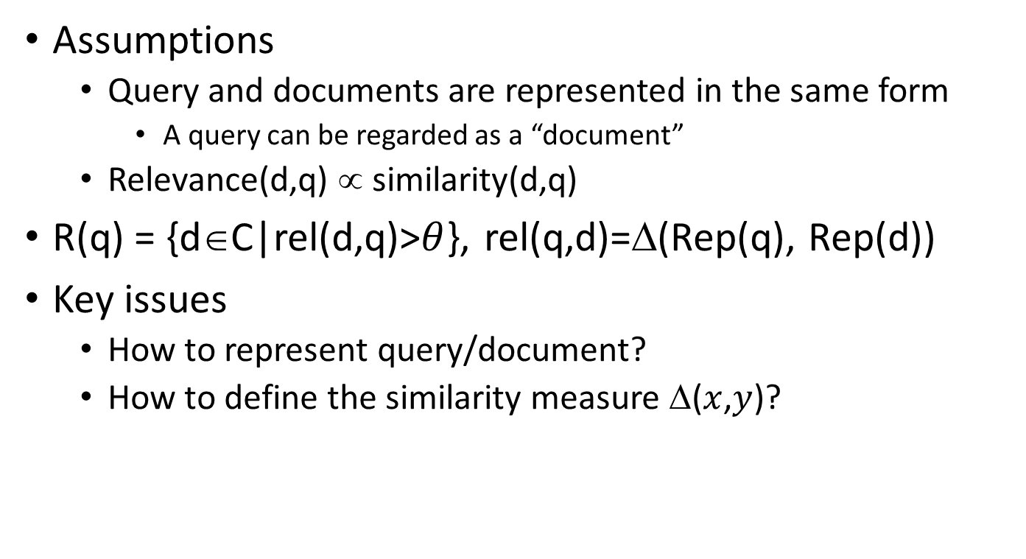
Relevance = Similarity
Assumptions
Query and documents are represented in the same form
A query can be regarded as a “document”
Relevance(d,q) ∝ similarity(d,q)
R(q) = {d∈C|rel(d,q)>$θ$}, rel(q,d)=Δ(Rep(q), Rep(d))
Key issues
How to represent query/document?
How to define the similarity measure Δ($x$,$y$)?

Slide 22
Vector space model
Represent both document and query by concept vectors
Each concept defines one dimension
K concepts define a high-dimensional space
Element of vector corresponds to concept weight
E.g., d=(x₁,…,x_{k}), x_{i} is “importance” of concept i
Measure relevance
Distance between the query vector and document vector in this concept space

Slide 23
What is a good “basic concept”?
Orthogonal
Linearly independent basis vectors
“Non-overlapping” in meaning
No ambiguity
Weights can be assigned automatically and accurately
Existing solutions
Terms or N-grams, i.e., bag-of-words
Topics, i.e., topic model

Slide 24
How to assign weights?
Important!
Why?
Query side: not all terms are equally important
Document side: some terms carry more information about the content
How?
Two basic heuristics
TF (Term Frequency) = Within-doc-frequency
IDF (Inverse Document Frequency)

Slide 25
Cosine similarity
TF-IDF vector
Angle between two vectors
$cosine\left(V_{q},V_{d}\right)=\frac{V_{q}×V_{d}}{{\left|V_{q}\right|}_{2}×{\left|V_{d}\right|}_{2}}=\frac{V_{q}}{{\left|V_{q}\right|}_{2}}×\frac{V_{d}}{{\left|V_{d}\right|}_{2}}$
Document length normalized
Unit vector
Finance
D₂
TF-IDF space
D₁
Query
Sports

Slide 26
Justification
From decision theory
Two types of loss
Loss(retrieved|non-relevant)=$a_{1}$
Loss(not retrieved|relevant)=$a_{2}$
$φ(d_{i},q)$: probability of $d_{i}$ being relevant to $q$
Expected loss regarding to the decision of including $d_{i}$ in the final results
Retrieve: $\left(1−φ\left(d_{i},q\right)\right)a_{1}$
Not retrieve: $φ\left(d_{i},q\right)a_{2}$

Slide 27
Justification
From decision theory
We make decision by
If $\left(1−φ\left(d_{i},q\right)\right)a_{1}$<$φ\left(d_{i},q\right)a_{2}$, retrieve $d_{i}$
Otherwise, not retrieve $d_{i}$
Check if $φ\left(d_{i},q\right)>\frac{a_{1}}{a_{1}+a_{2}}$
Rank documents by descending order of $φ\left(d_{i},q\right)$ would minimize the loss

Slide 28
Conditional models for P(R=1|Q,D)
Basic idea: relevance depends on how well a query matches a document
P(R=1|Q,D)=g(Rep(Q,D),θ)
Rep(Q,D): feature representation of query-doc pair
E.g., #matched terms, highest IDF of a matched term, docLen
Using training data (with known relevance judgments) to estimate parameter θ
Apply the model to rank new documents
Special case: logistic regression
a functional form

Slide 29
Generative models for P(R=1|Q,D)
Basic idea
Compute Odd(R=1|Q,D) using Bayes’ rule
Assumption
Relevance is a binary variable
Variants
Document “generation”
P(Q,D|R)=P(D|Q,R)P(Q|R)
Query “generation”
P(Q,D|R)=P(Q|D,R)P(D|R)
Ignored for ranking

Slide 30
Robertson-Sparck Jones Model (Robertson & Sparck Jones 76)
(RSJ model)
Two parameters for each term A_{i}:
p_{i} = P(A_{i}=1|Q,R=1): prob. that term A_{i} occurs in a relevant doc
u_{i} = P(A_{i}=1|Q,R=0): prob. that term A_{i} occurs in a non-relevant doc
How to estimate these parameters?
Suppose we have relevance judgments,
“+0.5” and “+1” can be justified by Bayesian estimation as priors
Per-query estimation!

Slide 31
Maximum likelihood vs. Bayesian
Maximum likelihood estimation
“Best” means “data likelihood reaches maximum”
Issue: small sample size
Bayesian estimation
“Best” means being consistent with our “prior” knowledge and explaining data well
A.k.a, Maximum a Posterior estimation
Issue: how to define prior?
$$\hat{θ}={argmax}_{θ}P(X|θ)$$
ML: Frequentist’s point of view
$$\hat{θ}={argmax_{θ}P\left(θ | X\right)=argmax}_{θ}P\left(X | θ\right)P(θ)$$
MAP: Bayesian’s point of view

Slide 32
BM25/Okapi approximation (Robertson et al. 94)
Idea: model p(D|Q,R) with a simpler function that approximates 2-Possion mixture model
Observations:
log O(R=1|Q,D) is a sum of term weights occurring in both query and document
Term weight W_{i}= 0, if TF_{i}=0
W_{i} increases monotonically with TF_{i}
W_{i} has an asymptotic limit
The simple function is

Slide 33
Adding doc. length
Incorporating doc length
Motivation: the 2-Poisson model assumes equal document length
Implementation: penalize long doc
where
Pivoted document length normalization

Slide 34
Query generation models
Query likelihood p(q| θ_{d})
Document prior
Assuming uniform document prior, we have
Now, the question is how to compute ?
Generally involves two steps:
(1) estimate a language model based on D
(2) compute the query likelihood according to the estimated model
Language models!

Slide 35
Language model for text
We need independence assumptions!
Probability distribution over word sequences
$p\left(w1 w2 … wn\right)=p\left(w1\right)p\left(w_{2} | w_{1}\right)p\left(w_{3} | w_{1},w_{2}\right)…p\left(w_{n} | w_{1},w_{2},…,w_{n−1}\right)$
Complexity - $O(V^{n^{∗}})$
$n^{∗}$ - maximum document length
sentence
Chain rule: from conditional probability to joint probability
475,000 main headwords in Webster's Third New International Dictionary
Average English sentence length is 14.3 words
A rough estimate: $O({475000}^{14})$
$$\frac{{475000}^{14}}{8bytes×{\left(1024\right)}^{4}}≈3.38e^{66}TB$$
How large is this?

Slide 36
Illustration of language model smoothing
P(w|d)
Max. Likelihood Estimate
Smoothed LM
w
Discount from the seen words
Assigning nonzero probabilities to the unseen words

